Slide 1

Strategic Human Resource Management (SHRM)

Slide 2
Strategic HRM
Strategic human resource management is the practice of attracting, developing, rewarding, and retaining employees for the benefit of both the employees as individuals and the organization as a whole.
HR departments that practice strategic human resource management do not work independently within a silo; they interact with other departments within an organization in order to understand their goals and then create strategies that align with those objectives, as well as those of the organization.
As a result, the goals of a human resource department reflect and support the goals of the rest of the organization.

Slide 3
Strategic HRM
Strategic HRM is seen as a partner in organizational success, as opposed to a necessity for legal compliance or compensation.
Strategic HRM utilizes the talent and opportunity within the human resources department to make other departments stronger and more effective.
Strategic human resource management can be defined as the linking of human resources with strategic goals and objectives in order to improve business performance and develop organizational culture that foster innovation, flexibility and competitive advantage. In an organisation SHRM means accepting and involving the HR function as a strategic partner in the formulation and implementation of the company's strategies through HR activities such as recruiting, selecting, training and rewarding personnel.

Slide 4
Strategic HRM
Strategic HRM gives direction on how to build the foundation for strategic advantage by creating an effective organizational structure and design, culture, employee value proposition, systems thinking, an appropriate communication strategy and preparing an organization for a changing landscape, which includes downturns and mergers & acquisitions.
Sustainability and corporate social responsibility come within the ambit of this discipline, especially with reference to organizational values and their expression in business decision making.

Slide 5
Strategic HRM
Strategic HRM emphasizes organizational codes of ethics, managing the societal impact of business decisions, philanthropy and the role of the human resource professional in improving the quality of life of employees, their families and the community at large.
Strategic human resource management includes typical human resource components such as hiring, discipline, and payroll, and also involves working with employees in a collaborative manner to boost retention, improve the quality of the work experience, and maximize the mutual benefit of employment for both the employee and the employer.

Slide 6
Strategic HRM
Strategic HRM, therefore, is concerned with the following:
Analyse the opportunities and threats existing in the external environment.
Formulate strategies that will match the organisation’s (internal) strengths and weaknesses with environmental (external) threats and opportunities. In other words, make a SWOT analysis of organisation.
Implement the strategies so formulated.
Evaluate and control activities to ensure that organisation’s objectives are duly achieved.

Slide 7
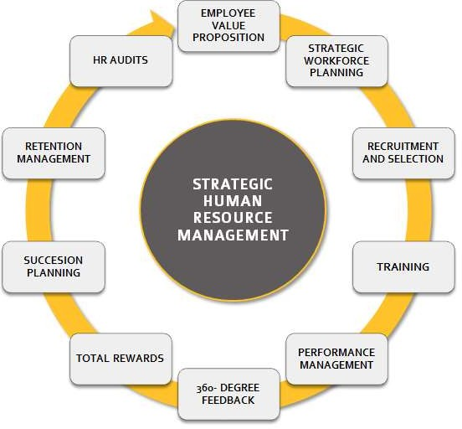

Slide 8
Nature of SHRM
Long-term Focus: As business strategies have a long-term orientation, therefore, focus of SHRM is also long-term probably more than one year.
Associated with Goal-Setting: SHRM is highly related with setting of objectives, formulation of policy and allocation of resources and it is carried out at all levels of top management.
Interrelated with Business Strategies: There is an interrelation between business strategies and SHRM. E.g. it gives significant inputs when business strategy is formulated, and human resource strategies (like recruitment, staffing, training and performance appraisal).
Fosters Corporate Excellence Skills: SHRM considers employees as the strategic potential of the organization and on that basis makes effort to differentiate the organization from its competitors present in the markets. It also promotes learning of modern skills.

Slide 9
Aims of SHRM
To develop Strategic Competencies: to make sure that the company has needed standards and competent and highly motivated employees for achieving sustainable competitive advantage.
To give Sense of Direction: It guides the organization in the right direction so that the business requirements of the organization and the individual as well as the co- operative requirements of its employees are met by creation and attainment of consistent and reasonable HR policies and programmes.
To achieve Integration: Target of SHRM is to give a united framework, so that the organized HR system works synergistically in accordance with the organizational strategic objectives.
To formulate Business Strategy: by focusing on the measures through which the organization can use the power of its human resources for the increasing benefits.

Slide 10
Key Features of Strategic Human Resource Management
There is an explicit linkage between HR policy and practices and overall organizational strategic aims and the organizational environment.
There is some organizing schema linking individual HR interventions so that they are mutually supportive.
Much of the responsibility for the management of human resources is devolved down the line.

Slide 11
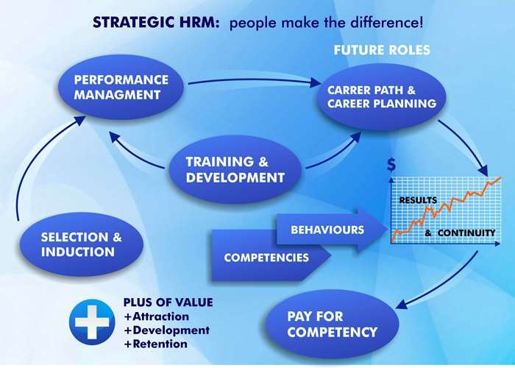

Slide 12
Approaches of the SHRM
Attempts to link Human Resource activities with competency based performance measures.
Attempts to link Human Resource activities with business surpluses or profit.
These two approaches indicate two factors in an organisational setting.
The first one is the human factor, their performance and competency and the later is the business surplus.

Slide 13
Approaches of the SHRM
An approach of people concern is based on the belief that human resources are uniquely important in sustained business success.
An organization gains competitive advantage by using its people effectively, drawing on their expertise and ingenuity to meet clearly defined objectives.
Integration of the business surplus to the human competency and performance required adequate strategies. Here the role of strategy comes into picture. The way in which people are managed, motivated and deployed, and the availability of skills and knowledge will all shape the business strategy. The strategic orientation of the business then requires the effective orientation of human resource to competency and performance excellence

Slide 14
Barriers of SHRM
Barriers to successful SHRM implementation are complex. The main reason is a lack of growth strategy or failure to implement one. Other major barriers are summarized as follows:
Inducing the vision and mission of the change effort.
High resistance due to lack of cooperation from the bottom line.
Interdepartmental conflict.
The commitment of the entire senior management team.
Plans that integrate internal resource with external requirements.
Limited time, money and the resources.
The statusquo approach of employees.
Fear of incompetency of senior level managers to take up strategic steps.
Diverse work-force with competitive skill sets.

Slide 15
Barriers of SHRM
Fear towards victimisation in the wake of failures.
Improper strategic assignments and leadership conflict over authority.
Ramifications for power relations.
Vulnerability to legislative changes.
Resistance that comes through the legitimate labour institutions.
Presence of an active labour union.
Rapid structural changes.
Economic and market pressures influenced the adoption of strategic HRM.
More diverse, outward looking approach.

Slide 16
Benefits of SHRM
Identifying and analysing external opportunities and threats that may be crucial to the company's success.
Provides a clear business strategy and vision for the future.
To supply competitive intelligence that may be useful in the strategic planning process.
To recruit, retain and motivate people.
To develop and retain of highly competent people.

Slide 17
Benefits of SHRM
To ensure that people development issues are addressed systematically.
To supply information regarding the company's internal strengths and weaknesses.
To meet the expectations of the customers effectively.
To ensure high productivity.
To ensure business surplus thorough competency.

Slide 18

5P Model of SHRM
The 5Ps model of strategic human resource management (SHRM) is a new model in the area of study. This model is proposed by Randal Schuler.
This model melds five human resource activities with strategic highlight just how significant, the strategy activity link can be.

Slide 19
5P Model of SHRM
The proposed model incorporates the 5Ps of strategic human resource management which stand for:
Philosophy of Human resources
Policies human resources
Programme of human resources
Practices of human resources
Processes of human resources

Slide 20
5P Model of SHRM
Philosophy: Expressed in statements defining business values and culture. It expresses how to treat and value people.
Policies: Expressed as shared values and guidelines. Policies establish guidelines for action on people related business issues and HR programs.
Programs: Articulated as human resource strategy. These coordinate efforts to facilitate change to address major people related business issues.
Practices: For leadership managerial and operational role practices motivate needed role behaviours.
Processes: For the formulation and implementation of other activities these define how activities are carried out.

Slide 21
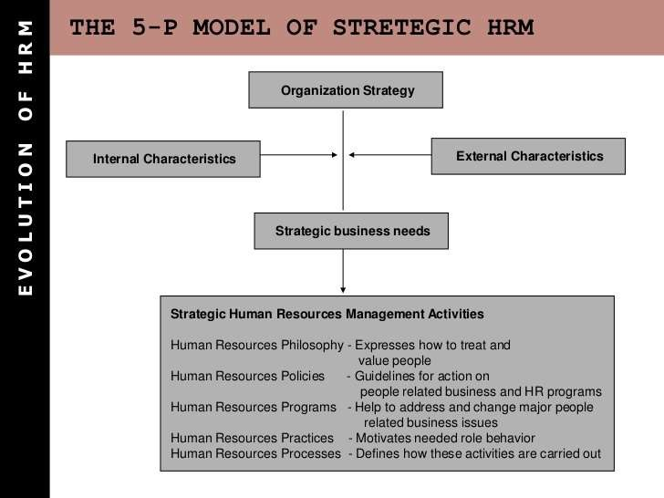

Slide 22

How SHRM differs from HRM
In the last two decades there has been an increasing awareness that HR functions were like an island unto itself with softer people-centred values far away from the hard world of real business.
In order to justify its own existence HR functions had to be seen as more intimately connected with the strategy and day to day running of the business side of the enterprise. Many writers in the late 1980s, started clamouring for a more strategic approach to the management of people than the standard practices of traditional management of people or industrial relations models.

Slide 23
How SHRM differs from HRM
Strategic human resource management focuses on human resource programs with long- term objectives. Instead of focusing on internal human resource issues, the focus is on addressing and solving problems that effect people management programs in the long run and often globally. Therefore the primary goal of strategic human resources is to increase employee productivity by focusing on business obstacles that occur outside of human resources.
The primary actions of a strategic human resource manager are to identify key HR areas where strategies can be implemented in the long run to improve the overall employee motivation and productivity. Communication between HR and top management of the company is vital as without active participation no cooperation is possible.

Slide 24
How SHRM differs from HRM
In the last two decades there has been an increasing awareness that HR functions were like an island unto itself with softer people-centred values far away from the hard world of real business.
In order to justify its own existence HR functions had to be seen as more intimately connected with the strategy and day to day running of the business side of the enterprise. Many writers in the late 1980s, started clamouring for a more strategic approach to the management of people than the standard practices of traditional management of people or industrial relations models.

Slide 25
How SHRM differs from HRM
Strategic human resource management focuses on human resource programs with long- term objectives. Instead of focusing on internal human resource issues, the focus is on addressing and solving problems that effect people management programs in the long run and often globally. Therefore the primary goal of strategic human resources is to increase employee productivity by focusing on business obstacles that occur outside of human resources.
The primary actions of a strategic human resource manager are to identify key HR areas where strategies can be implemented in the long run to improve the overall employee motivation and productivity. Communication between HR and top management of the company is vital as without active participation no cooperation is possible.

Slide 26
Importance of SHRM
Helps firm in achieving cost-effective engagement of Labour.
Enables firm to meet changing needs.
Provides clear-cut goals, direction, and future focus.
Helps Organization in Planning and Executing Organizational Changes.
Ensures Optimum Utilization of Organizational Resources.
Develops, Manages and Sustains Skills and Knowledge.

Slide 27

Challenges of SHRM
Absence of Long-term orientation
Lack of Strategic Reasoning
Lack of adequate support from top management
Resistance from Labour Unions
Fear of Failure
Rigidity of HR Practices

Slide 28

Overcoming Challenges of SHRM
Conduct a rigorous initial analysis
Formulate Strategy
Gain Support
Assess barriers
Manage Change
Project Management and Implementation
Follow-up and Evaluate

Slide 29
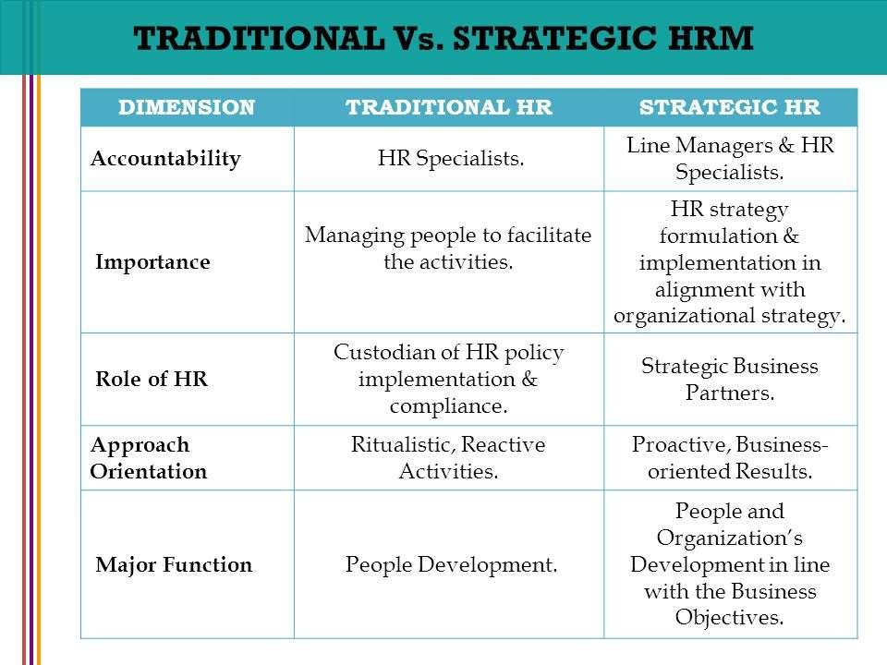
Difference between Traditional HR and Strategic HR

Slide 30
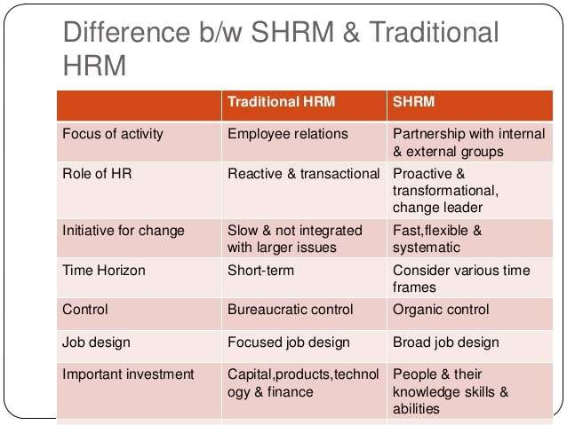

Slide 31



